Slide 1
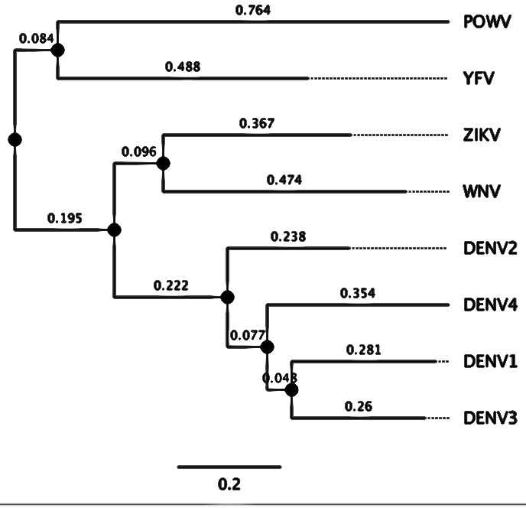
Phylogenetics: Basic principles
EMD 531
Lecture 7
anderson brito, phd

Slide 2
Outline
Fundamental concepts in Phylogenetics
Reading a tree
Tree space
Phylogenetic methods
Pairwise Distance
Maximum Parsimony
Maximum Likelihood
Bayesian Inference
Genetic distance & substitution models
Substitution and transition rates
Transitions and Transversions
Rate heterogeneity
Clock models
Time-resolved trees
Statistical test
Bootstrapping

Slide 3
Fundamental concepts in Phylogenetics

Slide 4
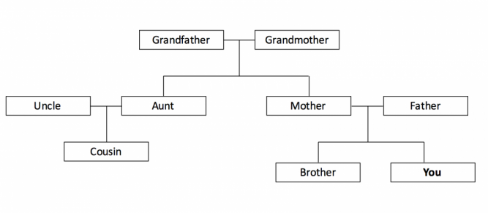
What is phylogenetics?
👴🏻
👵🏼
Phylogenetics is the study of evolutionary relationships among biological entities (populations, organisms, genes)
🧔🏼
🧑🏻
👩🏻
👨🏽
👱🏼‍♀️
👶🏼
👧🏻
Such relationships are almost always inferred from molecular sequence data
DENV1
DENV1 CGTTGCTGAAAT
DENV3 CGTTGATGAGAA
ZIKV GGTAGATGAACG
YFV GGCTGAAGATCT
DENV3
ZIKV
YFV

Slide 5
Reading a phylogenetic tree
Evolutionary relationships are commonly represented by bifurcating diagrams, also known as “trees”, which show five main components:
Monophyletic clade
(group sharing a common ancestor)
Dengue virus 1
Internal node
(ancestors)
Tips / Leafs
(sampled taxa)
Phylogeny (tree)
Most Recent Common Ancestors (MRCA, tree root)
Dengue virus 2
Branch
(time or genetic distance)
Zika virus
outgroup
()

Slide 6
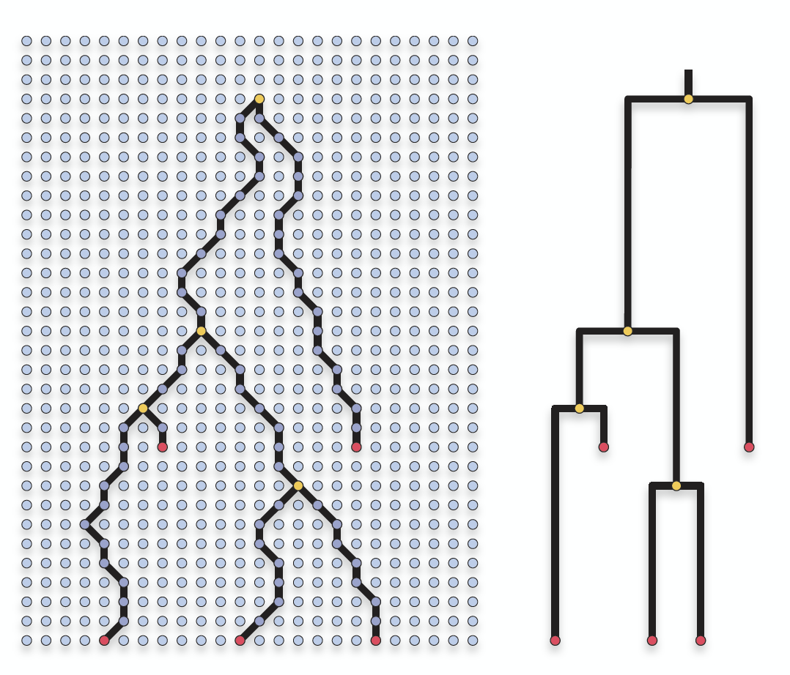
Tree: a hypothesis, an approximation of the true story
PAST
PRESENT

Slide 7
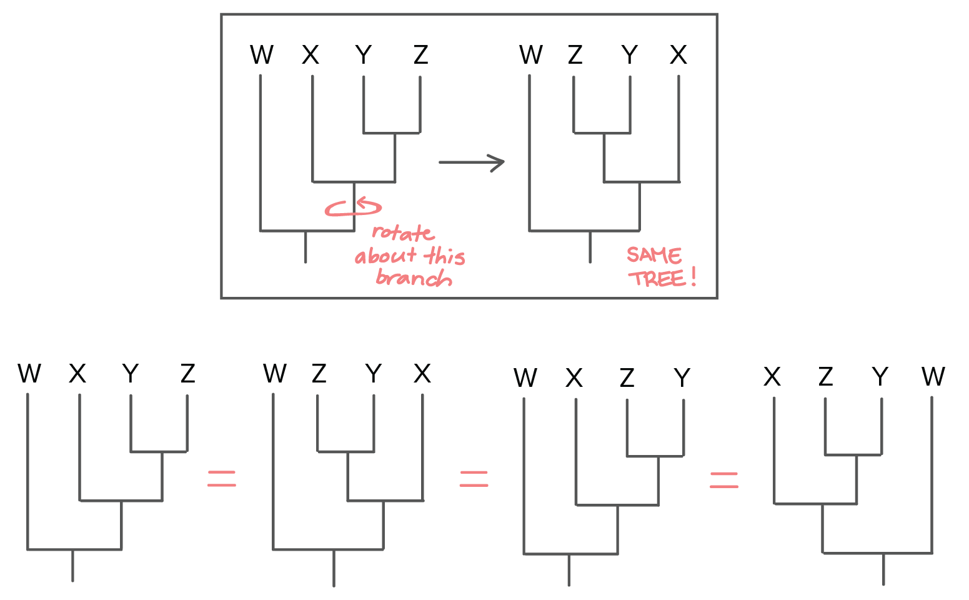
Branch rotations don’t change the tree
(Robert Bear)

Slide 8
How many rooted trees with 4 taxa are there?
W
W
W
W
W
Y
X
Z
X
Y
X
Y
Y
Y
X
Z
Z
X
Z
Z
W
Y
Y
Y
Z
Z
Z
W
X
X
X
W
X
W
W
Y
X
Z
Z
Y
Z
Z
X
X
X
W
Y
W
Y
Z
Y
W
Y
W
W
X
X
Z
Z
Y

Slide 9
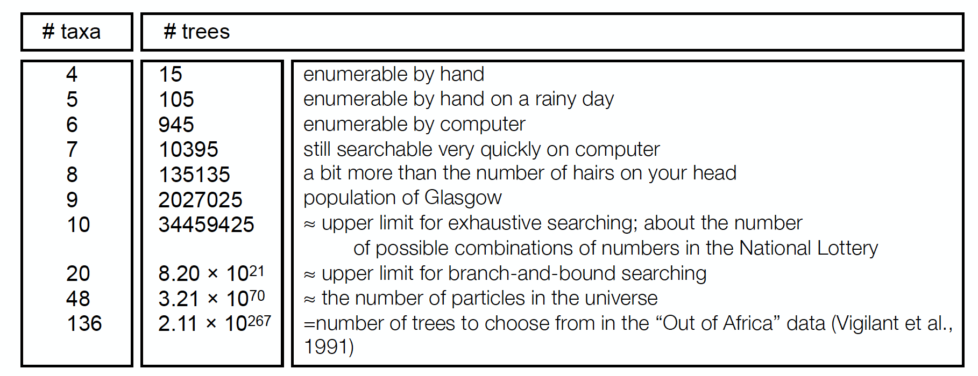
Few taxa, lots of possible trees
(2n-3)! / (2n-2)*(n-2)!
(Philippe Lemey)

Slide 10
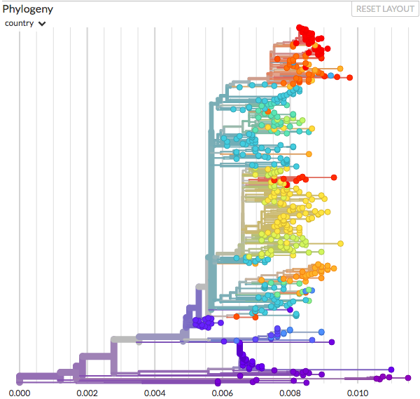
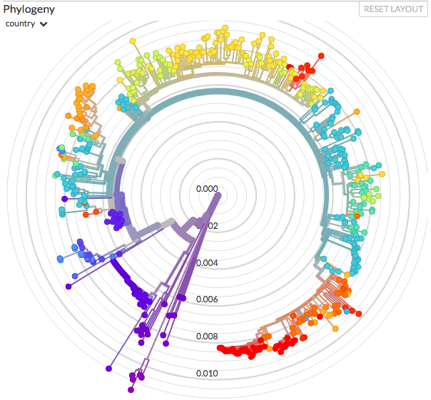
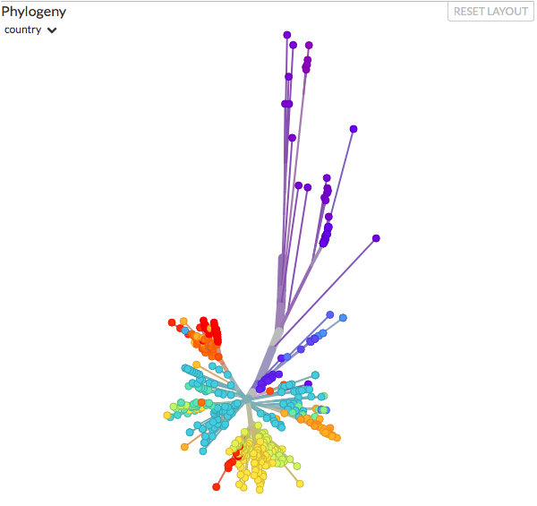
Distinct representations of the same tree
Source: nextsrain.org
Radial Rooted trees
(when the outgroup is known)
Unrooted tree
(direction of evolution unknown)
Rectangular Rooted trees
(when the outgroup is known)

Slide 11
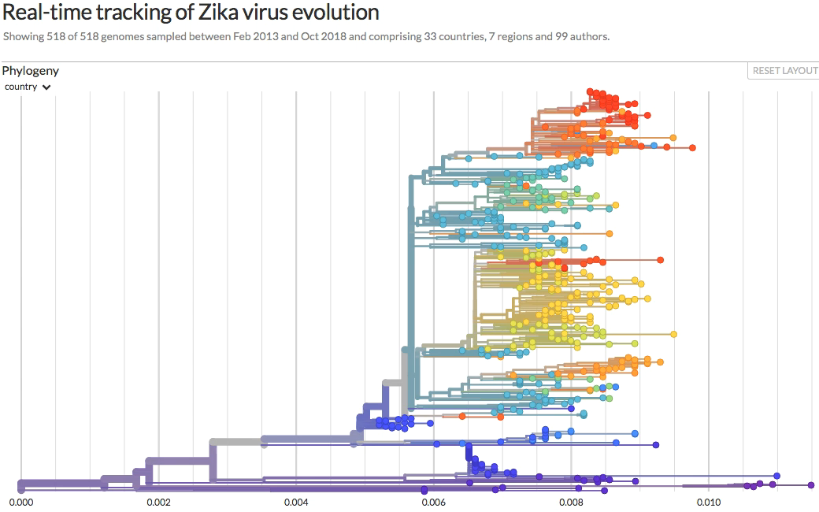
Distinct representations of the same tree

Slide 12
Phylogenetic methods

Slide 13
Phylogenetic methods
 | Character-based methods | Non-character-based methods
Uses an explicit model of evolution | Maximum likelihood | Pairwise distance (UPGMA & Neighbor-Joining)
 | Bayesian inference
Do not use an explicit model of evolution | Maximum parsimony

Slide 14
Maximum Parsimony (MP)
 | Character-based methods | Non-character-based methods
Uses an explicit model of evolution | Maximum likelihood | Pairwise distance (UPGMA & Neighbor-Joining)
 | Bayesian inference
Do not use an explicit model of evolution | Maximum parsimony

Slide 15
Maximum Parsimony and the Ockham’s Razor
MP aims to reconstruct trees that minimize the amount of evolutionary change required to explain the data.
T → A → G → C
Multiple mutations
✕
✂
“Ockham’s Razor”: avoid unnecessary complexity. The simplest hypothesis, involving less steps, should be preferred.
T → C
✓
Few mutations

Slide 16
MP with morphological characters
 | Jaws | Lungs | Gizzard | Fur | Feathers
🐞 | ○ | ○ | ○ | ○ | ○
🦈 | ● | ○ | ○ | ○ | ○
🦃 | ● | ● | ● | ○ | ●
🐊 | ● | ● | ● | ○ | ○
🐈 | ● | ● | ○ | ● | ○
🐞
🦈
🦃
🐊
🐈
●
●
●
●
●
Best tree topology and less costly scenario

Slide 17
Searching for topologies and possible scenarios
🦃
🐞
🐊
🐈
🦈
🐞
🐈
🦃
🦈
🐊
🐈
🐞
🦃
🐊
🦈
🐞
🦈
🦃
🐊
🐈
●
○
○
●
○
●
●
○
○
●
○
●
○
○
○
●
○
○
●
●
○
○
●
●
↻
●
↻
…
●
●
●
●
●
●
●
●
✨
11 steps
9 steps
8 steps
5 steps
Many topologies and scenarios are proposed until one or more (less costly) parsimonious trees are found
Traits
● Jaws ● Lungs ● Gizzard ● Fur ● Feathers
Events
● Gain ○ Loss

Slide 18
MP with molecular data: costs and tree searching
W CGTTGCTGAAAT
X CGTTGATGAGAA
Y GGTAGATGAACG
Z GGCTGAAGATCT
W
X
Y
Z
W
X
Y
Z
W
X
Y
Z
C
C
G
G
C
C
G
G
C
C
G
G
1
1
0
0
0
0
1
A
1
G
0
G
1
1
…
0
A
0
↻
A
1
C
1
A
0
A
0
C
0
✨
Cost = 4
(1 + 1 + 1 + 1 + 0 + 0)
Cost = 3
(1 + 1 + 1 + 0 + 0 + 0)
Cost = 1
(1 + 0 + 0 + 0 + 0 + 0)
 | A | C | G | T
A | 0 | 1 | 1 | 1
C | 1 | 0 | 1 | 1
G | 1 | 1 | 0 | 1
T | 1 | 1 | 1 | 0
An alignment site is selected
Its intermediate cost is computed
Cost matrix
↻
A tree topology is sampled
A set of ancestral states is proposed
↻
One or more low-cost scenarios are found
X ⇄ Y = 1
No change = 0

Slide 19
Pairwise distance methods
 | Character-based methods | Non-character-based methods
Uses an explicit model of evolution | Maximum likelihood | Pairwise distance (UPGMA & Neighbor-Joining)
 | Bayesian inference
Do not use an explicit model of evolution | Maximum parsimony

Slide 20
Unweighted-Pair Group Method with Arithmetic Means (UPGMA)
Distance methods, like UPGMA, use pairwise distances to infer evolutionary relationships
Alignment
DENV1 CGTTGCTGAAAT
DENV3 CGTTGATGAGAA
ZIKV GGTAGATGAACG
YFV GGCTGAAGATCT
1.5
1
DENV1
1.5
0.5
DENV3
Distance matrix
 | DENV1 | DENV3 | ZIKV | YFV
DENV3 | 3 | -
ZIKV | 5 | 5 | -
YFV | 6 | 6 | 6 | -
2.5
ZIKV
3
YFV

Slide 21
UPGMA algorithm
Distance matrix
 | DENV1 | DENV3 | ZIKV | YFV
DENV3 | 3 | -
ZIKV | 5 | 5 | -
YFV | 6 | 6 | 6 | -
𝚍D₁D₃ = 3
Distance matrix
 | D₁D₃Z | YFV
YFV | 6 | -
1.5
DENV1
1.5
DENV3
1.5
DENV1
Distance matrix
 | D₁D₃ | ZIKV | YFV
ZIKV | 5 | -
YFV | 6 | 6 | -
1
1.5
0.5
1.5
DENV3
1
DENV1
1.5
DENV3
2.5
ZIKV
𝚍(D₁D₃)Z = (𝚍D₁Z + 𝚍D₃Z) / 2
2.5
3
ZIKV
YFV
(5 + 5) / 2 = 5
𝚍(D₁D₃)Y = (6 + 6) / 2 = 6

Slide 22
UPGMA disadvantages
UPGMA assumes that substitution rates are the same for all lineages.
1.5
DENV1
1
0.5
1.5
DENV3
2.5
ZIKV
UPGMA trees are ultrametric: that is, distances between the root and any
tip are always the same
3
YFV

Slide 23
Neighbor-Joining (NJ): a different distance method
Distance matrix
 | A | B | C | D | E
B | 5 | -
C | 4 | 7 | -
D | 7 | 10 | 7 | -
E | 9 | 12 | 9 | 8 | -
1
1
Virus A
4
1
Virus B
𝚛_{A} = 5 + 4 + 6 + 9 = 25
2
𝚛_{B} = 34
𝚛_{C} = 27
𝚛_{D} = 32
𝚛_{e} = 38
Virus C
𝙼 _{XY} = 𝚍 _{XY} − (𝚛_{X} + 𝚛_{Y}) / (𝙽 − 2)
𝙼 _{AB} = 5 − (25 + 34) / (5 − 2) = -9.75
3
Virus D
Rate-corrected distance matrix
 | A | B | C | D | E
B | -9.75 | -
C | -9 | -8.25 | -
D | -7.25 | -6.5 | -7.75 | -
E | -6.75 | -6 | -7.25 | -9.5 | -
1
2
Virus E

Slide 24
Genetic distance & substitution models

Slide 25
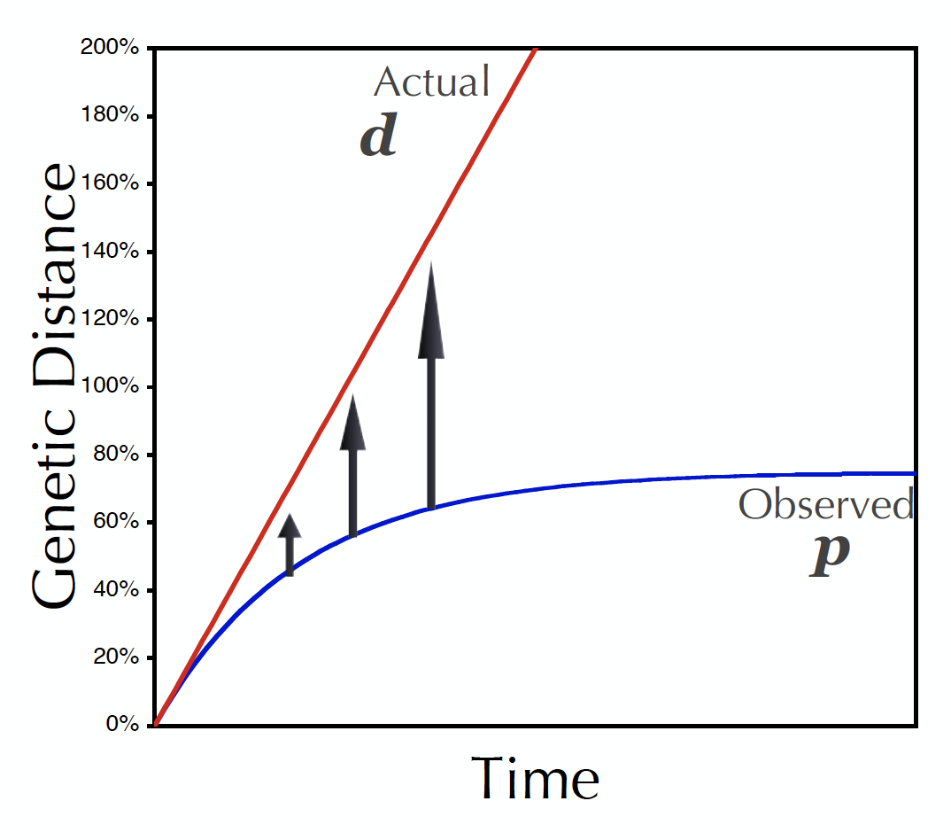
Observed distance (p) × expected genetic distance (d)
DENV1 CGTTGCTGAAAT
DENV3 CGTTGATGAGAA
ZIKV GGTAGATGAACG
YFV GGCTGAAGATCT
T → A → G → C
A → T → A
Multiple mutations
Back mutations
Sequence evolution can be better described
with mathematical models
(Philippe Lemey)

Slide 26
Calculating genetic distances
DENV1 AAAAGTCAGGTCAAACGCAGCTATTGGAGCAGTGTTCGTTGATGAAAATCA
DENV2 AAAGGTGAGAAGCAATGCAGCCTTGGGGGCCATATTCACTGATGAGAACAA
DENV3 AAAGGTCAGAACTAACGCAGCCATGGGCGCCGTTTTCACAGAGGAGAACCA
DENV4 AAAAGTTAGATCAAACGCAGCCATAGGCGCAGTCTTTCAGGAAGAACAGGG
ZIKV CAAGGTGCGCAGCAATGCAGCACTGGGAGCAATATTTGAAGAGGAAAAAGA
WNV AAAAGTCAACAGTAATGCCGCCCTAGGAGCGATGTTTGAAGAACAGAACCA
YFV AAAAGTCCGAAGTCATGCAGCCATTGGAGCTTACCTGGAAGAACAAGAACA
POWV GAAGGTGAGGTCCAACGCTGCTCTAGGTGCATGGTCGGATGAACAGAATAA
Substitution models are used to convert measures of sequence dissimilarity into genetic distances, accounting for multiple mutations and back mutations.
T → A → G → C
A → T → A
Multiple mutations
Back mutations
DENV1 | 0.000
DENV2 | 0.373 | 0.000
DENV3 | 0.294 | 0.216 | 0.000
DENV4 | 0.294 | 0.431 | 0.333 | 0.000
ZIKV | 0.392 | 0.294 | 0.373 | 0.412 | 0.000
WNV | 0.373 | 0.353 | 0.333 | 0.412 | 0.314 | 0.000
YFV | 0.392 | 0.451 | 0.392 | 0.412 | 0.373 | 0.314 | 0.000
POWV | 0.333 | 0.412 | 0.451 | 0.431 | 0.412 | 0.392 | 0.490 | 0.000
 | DENV1 | DENV2 | DENV3 | DENV4 | ZIKV | WNV | YFV | POWV
Substitution model
DENV1 | 0.000
DENV2 | 0.358 | 0.000
DENV3 | 0.343 | 0.349 | 0.000
DENV4 | 0.387 | 0.392 | 0.370 | 0.000
ZIKV | 0.656 | 0.583 | 0.668 | 0.612 | 0.000
WNV | 0.564 | 0.562 | 0.557 | 0.544 | 0.562 | 0.000
YFV | 0.456 | 0.474 | 0.495 | 0.481 | 0.616 | 0.570 | 0.000
POWV | 0.523 | 0.502 | 0.519 | 0.560 | 0.599 | 0.574 | 0.454 | 0.000
 | DENV1 | DENV2 | DENV3 | DENV4 | ZIKV | WNV | YFV | POWV
𝚡𝜇𝛑_{nt}
Correction for multiple mutations
Matrix of dissimilarities (pairwise relative differences)
Distance matrix (expected pairwise genetic distance)

Slide 27
Substitution models
Generic substitution model (Rate matrix)
 | A | C | G | T
A |  | 𝚊𝜇𝛑_{C} | 𝚋𝜇𝛑_{G} | 𝚌𝜇𝛑_{T}
C | 𝚐𝜇𝛑_{A} |  | 𝚍𝜇𝛑_{G} | 𝚎𝜇𝛑_{T}
G | 𝚑𝜇𝛑_{A} | 𝚒𝜇𝛑_{C} |  | 𝚏𝜇𝛑_{T}
T | 𝚓𝜇𝛑_{A} | 𝚔𝜇𝛑_{C} | 𝚕𝜇𝛑_{G}
𝚡𝜇𝛑_{nt}
𝚡 = transition rate parameter (relative rate of substitution from one nt to another)
𝜇 = mean substitution rate (unit = substitutions/site)
𝛑_{nt} = nucleotide frequency parameter (relative frequency of nt in the alignment)

Slide 28
Jukes-Cantor (JC): A simple substitution model
 | A | C | G | T
A |  | 𝜇¼ | 𝜇¼ | 𝜇¼
C | 𝜇¼ |  | 𝜇¼ | 𝜇¼
G | 𝜇¼ | 𝜇¼ |  | 𝜇¼
T | 𝜇¼ | 𝜇¼ | 𝜇¼
𝚡𝜇𝛑_{nt}
𝚡 = 1 (all nt change to any other nt at equal rates)
𝜇 = same substitution rate for all sites
𝛑_{nt} = 0.25 (all nt equally frequent)

Slide 29
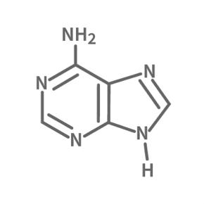
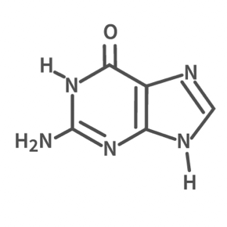
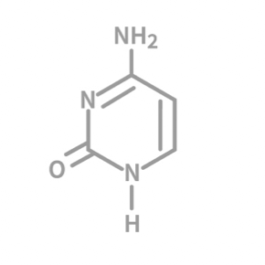
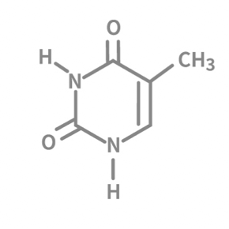
Adding complexity to substitution models
Transition
Adenine
A
G
Guanine
Transversions
C
T
Transition
Cytosine
Thymine

Slide 30
HKY85: accounting for transitions and transversions
 | A | C | G | T
A |  | 𝚊𝜇𝛑_{C} | 𝚋𝜇𝛑_{G} | 𝚌𝜇𝛑_{T}
C | 𝚊𝜇𝛑_{A} |  | 𝚍𝜇𝛑_{G} | 𝚎𝜇𝛑_{T}
G | 𝚋𝜇𝛑_{A} | 𝚍𝜇𝛑_{C} |  | 𝚏𝜇𝛑_{T}
T | 𝚌𝜇𝛑_{A} | 𝚎𝜇𝛑_{C} | 𝚏𝜇𝛑_{G}
𝚡𝜇𝛑_{nt}
𝚡 = transition rate parameter
(𝚊=𝚌=𝚍=𝚏 (transversions); 𝚋=𝚎 (transitions)
𝜇 = mean substitution rate (unit = substitutions/site)
𝛑_{nt} = nucleotide frequency parameter
(in HKY85, all 𝛑 are freely estimated from data)

Slide 31
GTR: exchangeability parameters estimated from data
 | A | C | G | T
A |  | 𝚊𝜇𝛑_{C} | 𝚋𝜇𝛑_{G} | 𝚌𝜇𝛑_{T}
C | 𝚊𝜇𝛑_{A} |  | 𝚍𝜇𝛑_{G} | 𝚎𝜇𝛑_{T}
G | 𝚋𝜇𝛑_{A} | 𝚍𝜇𝛑_{C} |  | 𝚏𝜇𝛑_{T}
T | 𝚌𝜇𝛑_{A} | 𝚎𝜇𝛑_{C} | 𝚏𝜇𝛑_{G}
𝚡𝜇𝛑_{nt}
𝚡 = transition rate parameter (only 6 substitution rate parameters (𝚊-𝚏); all freely estimated from data)
𝜇 = mean substitution rate (unit = substitutions/site)
𝛑_{nt} = nucleotide frequency parameter (all 𝛑 are freely estimated from data)

Slide 32
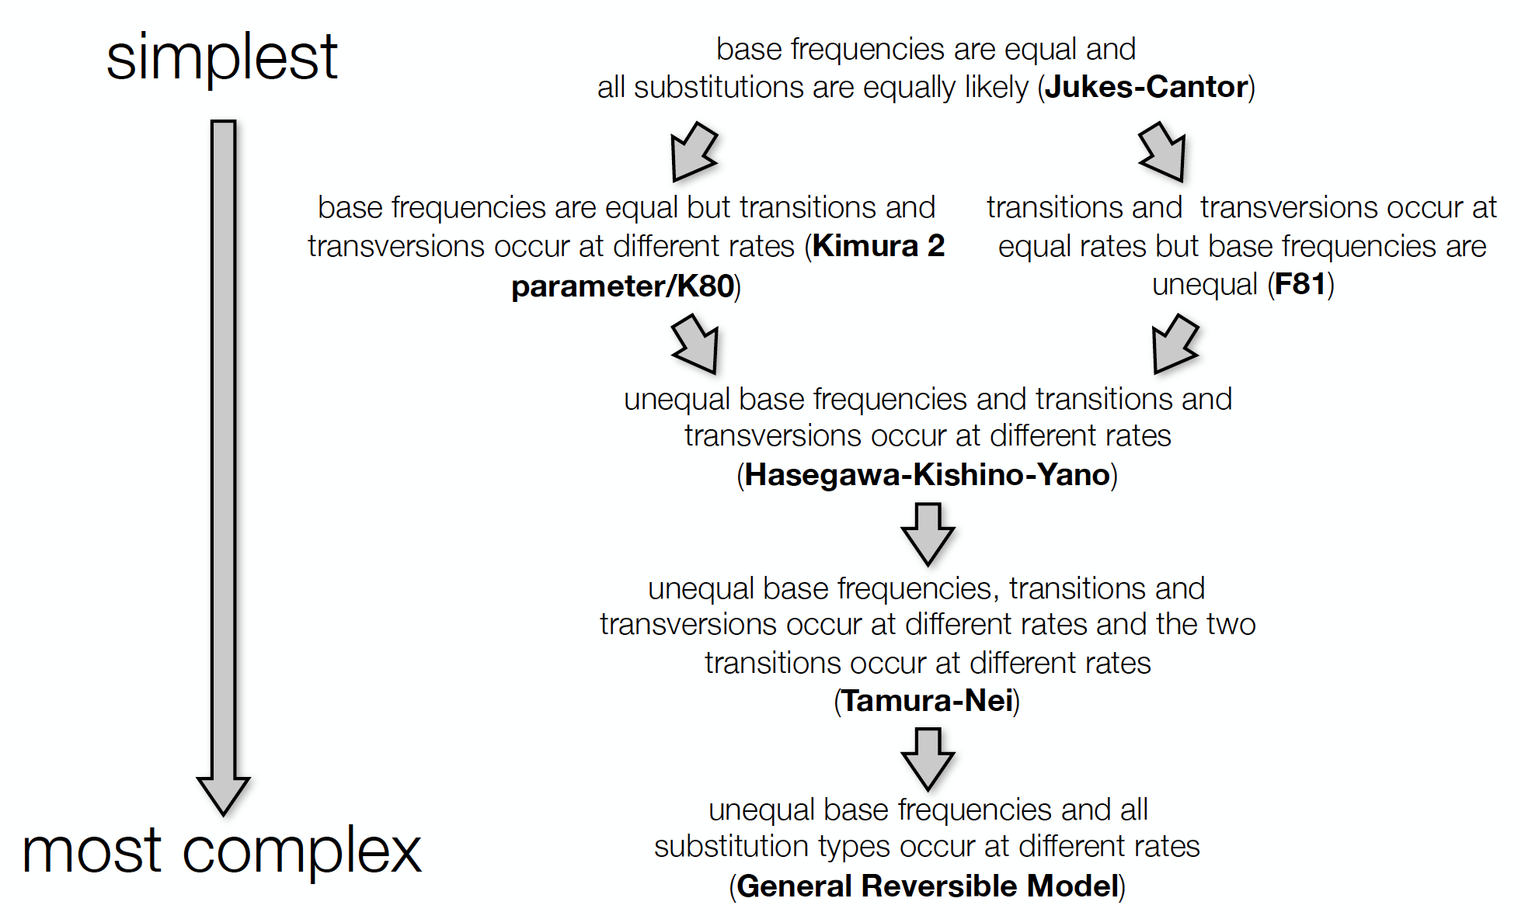
Diverse range of substitution models
(Philippe Lemey)

Slide 33
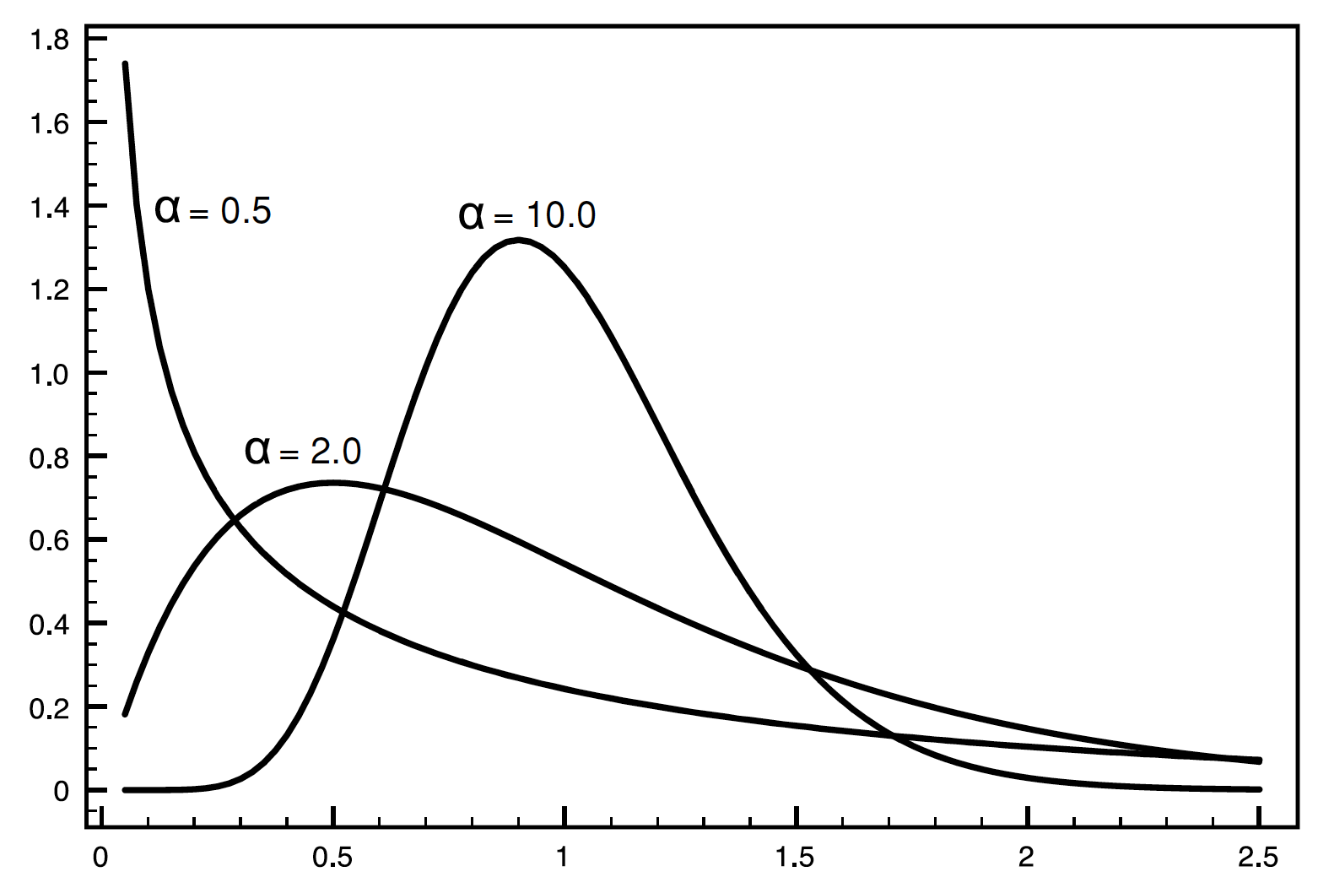
Rate heterogeneity among sites
𝚡𝜇𝛑_{nt}
Gamma (𝛤) distributions of substitution rates
𝜇 = mean substitution rate
(substitutions/site)
Proportion of sites
↑𝜇
↑𝜇
TAC TGA
↓𝜇
↓𝜇
↓𝜇
↓𝜇
Relative substitution rate
The 3rd site of a codon often evolves
faster than the 1st and 2nd sites
Parameter 𝛂 < 1 = strong rate heterogeneity Parameter 𝛂 > 1 = weak rate heterogeneity.

Slide 34
Maximum likelihood (ML)
 | Character-based methods | Non-character-based methods
Uses an explicit model of evolution | Maximum likelihood | Pairwise distance (UPGMA & Neighbor-Joining)
 | Bayesian inference
Do not use an explicit model of evolution | Maximum parsimony

Slide 35
Maximum likelihood methods
Searches for the most likely trees that explain the sampled data (alignment) given a substitution model
Many trees are proposed to explain the evolution of the sequences, and one of them is selected as the most likely hypothesis
ML explores multiple high likelihood trees (with similar topologies, “shapes”), and provide a relative support value for each internal node (clade) using statistical tests

Slide 36
Maximum likelihood methods
Alignment
CGTCGATGAAAA
DENV1 CGTTGCTGAAAT
DENV1 CGTTGCTGAAAT
DENV3 CGTTGATGAGAA
ZIKV GGTAGATGAACG
YFV GGCTGAAGATCT
GGTTGATGATCA
DENV3 CGTTGATGAGAA
GGCTGAAGAAGT
ZIKV GGTAGATGAACG
𝚡𝜇𝛑_{nt}
YFV GGCTGAAGATCT
Substitution model

Slide 37
ML approach
1
2
3
A
C
T
A
C
T
T
C
DENV1 AAA
DENV2 ACA
DENV3 ATA
DENV4 AAA
ZIKV CCA
WNV ATA
YFV ATA
POWV GCA
A
C
C
C
2
C
T
A
A
A
A
C
A
A
G
T
𝚡𝜇𝛑_{nt}
A
A
A
A
A
A
A
A
A
A
A
C
A
A
C
A
1
C
A
3
A
A
A
A
Alignment sites
(each column of the MSA)
Substitution model
(explains how sequences evolve)
𝘗 (ATCG| , 𝚡𝜇𝛑_{nt})
Repeat process over tree space, for all sites
(containing trees with different topologies)
Probability of sequences given the parameters (tree topology + substitution model)
The likelihood of a sequence alignment equals the product of the probabilities of reconstructed ancestral sites, given the tree topology and the model

Slide 38
Statistical test: Bootstrap

Slide 39
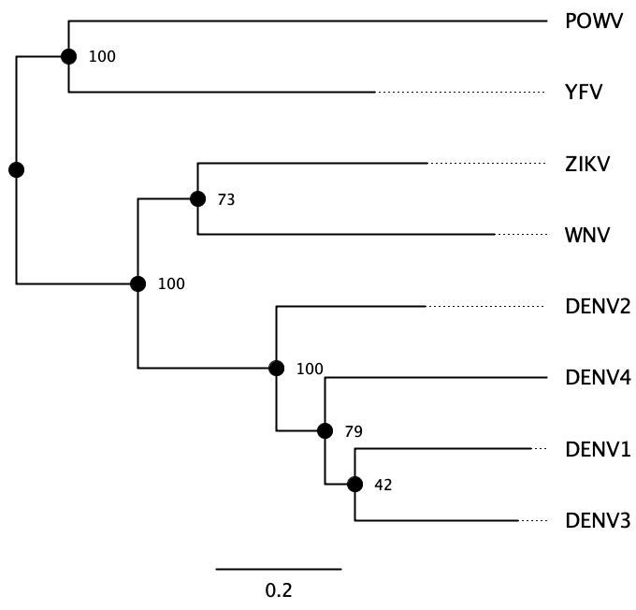
Evaluating tree support with bootstrap
Bootstrap tests the relative stability of clades after resampling, reporting how frequent such clades are over several tree reconstructions using shuffled alignments

Slide 40
Evaluating tree support with bootstrapping
Original alignment
Shuffled alignment
(bootstrap replicate 1)
DENV1 AAAAGTCAGGTCAAACGCAGCTATTGGAGCAGTGTTCGTTGATGAAAATCA
DENV2 AAAGGTGAGAAGCAATGCAGCCTTGGGGGCCATATTCACTGATGAGAACAA
DENV3 AAAGGTCAGAACTAACGCAGCCATGGGCGCCGTTTTCACAGAGGAGAACCA
DENV4 AAAAGTTAGATCAAACGCAGCCATAGGCGCAGTCTTTCAGGAAGAACAGGG
ZIKV CAAGGTGCGCAGCAATGCAGCACTGGGAGCAATATTTGAAGAGGAAAAAGA
WNV AAAAGTCAACAGTAATGCCGCCCTAGGAGCGATGTTTGAAGAACAGAACCA
YFV AAAAGTCCGAAGTCATGCAGCCATTGGAGCTTACCTGGAAGAACAAGAACA
POWV GAAGGTGAGGTCCAACGCTGCTCTAGGTGCATGGTCGGATGAACAGAATAA
DENV1 GCAGCTATTGGATGAAAATCAAGAGCAGTTTAAAGTCAGGTCAAACATCAA
DENV2 GCAGCCTTGGGATGAGAACAAAGGGCCATCTAAGGTGAGAAGCAATACAAA
DENV3 GCAGCCATGGGAGGAGAACCAAGCGCCGTCAAAGGTCAGAACTAACACCAA
DENV4 GCAGCCATAGGAAGAACAGGGAGCGCAGTAGAAAGTTAGATCAAACAGGGA
ZIKV GCAGCACTGGGAGGAAAAAGACGAGCAATAAAAGGTGCGCAGCAATAAGAC
WNV GCCGCCCTAGGAACAGAACCAAGAGCGATAAAAAGTCAACAGTAATACCAA
YFV GCAGCCATTGGAACAAGAACAAGAGCTTAAAAAAGTCCGAAGTCATAACAA
POWV GCTGCTCTAGGAACAGAATAAGGTGCATGATAAGGTGAGGTCCAACATAAG
Shuffled alignment
(bootstrap replicate 2)
Shuffled alignment
(bootstrap replicate N)
DENV1 GTTGACAGGTCAAACATTGCAGTGTTCGTTGATGAAAATCAGCAGCTCGCG
DENV2 ACTGAGAGAAGCAATTTGGCCATATTCACTGATGAGAACAAGCAGCCCACA
DENV3 ACAGACAGAACTAACATGGCCGTTTTCACAGAGGAGAACCAGCAGCCCACA
DENV4 CAGGATAGATCAAACATAGCAGTCTTTCAGGAAGAACAGGGGCAGCCTCTC
ZIKV GAAGAGCGCAGCAATCTGGCAATATTTGAAGAGGAAAAAGAGCAGCATGTG
WNV GAAGACAACAGTAATCTAGCGATGTTTGAAGAACAGAACCAGCCGCCTGTG
YFV GAAGACCGAAGTCATATTGCTTACCTGGAAGAACAAGAACAGCAGCCGGGG
POWV GATGAGAGGTCCAACCTAGCATGGTCGGATGAACAGAATAAGCTGCTGGGG
DENV1 TAAGGTCAAACGCATGAAATTGAAGCAGAGCAGTGTTCGTTGAATCAGTCA
DENV2 TAAGAAGCAATGCATGAGTTGGAGGGAGGGCCATATTCACTGAACAAGTGA
DENV3 TAAGAACTAACGCAGGAGATGGAGGCAGCGCCGTTTTCACAGAACCAGTCA
DENV4 TAAGATCAAACGCAAGAAATAGAAGTAGCGCAGTCTTTCAGGAAGGGGTTA
ZIKV TCAGCAGCAATGCAGGAACTGGAGGGCGAGCAATATTTGAAGAAAGAGTGC
WNV TAAACAGTAATGCCACAGCTAGAAGCAGAGCGATGTTTGAAGAACCAGTCA
YFV TAAGAAGTCATGCAACAAATTGAAGCCGAGCTTACCTGGAAGAAACAGTCC
POWV TGAGGTCCAACGCTACAGCTAGAGGGAGTGCATGGTCGGATGAATAAGTGA
Bootstrap alignments (replicates) are generated and used for tree inference

Slide 41
Errors can still occur
They arise through various mechanisms
Undersampling
Limited “genetic signal“
Contamination
Sequencing errors
Misclasification

Slide 42
Clock models

Slide 43
Adding a temporal scale
T → A
(substitutions/site)
Genetic change = Evolutionary rate
Sampling time
(substitutions/site/unit of time)
(unit of times)
⏳

Slide 44
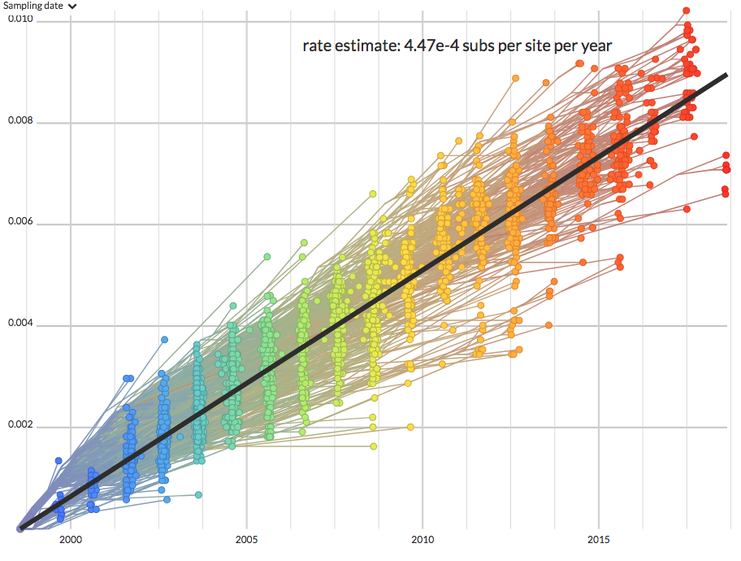
Molecular clock
Root-to-tip analysis
Used to estimate the Evolutionary rate
Not mutation rate or substitution rate
Must be “clock-like”
Genetic divergence
Time

Slide 45
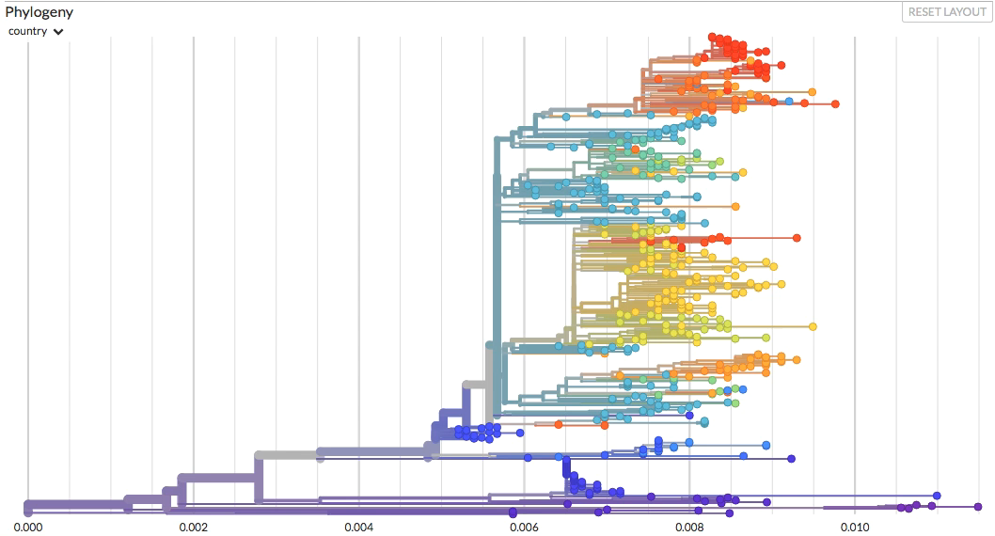
Divergence vs. time-resolved trees

Slide 46
Bayesian inference
 | Character-based methods | Non-character-based methods
Uses an explicit model of evolution | Maximum likelihood | Pairwise distance (UPGMA & Neighbor-Joining)
 | Bayesian inference
Do not use an explicit model of evolution | Maximum parsimony

Slide 47
Bayesian methods
Bayesian phylogenetic inference takes advantage of likelihood estimates (like in maximum likelihood approaches), but allow the incorporation of multiple other parameters (priors) in the model
Among such parameters are:
Molecular clock: assumption that sequence changes are accumulate at roughly similar rates
Demographic measures: population dynamics data
Dates: temporal measures of sampling or divergence times
Locations: discrete or continuous (coordinates) values for sampling origin

Slide 48
Bayes theorem applied to phylogenetics
Measure similar to the LIKELIHOOD computed in Maximum Likelihood methods
Parameters are known as ‘PRIORS’
Probability of parameters (tree, the substitution model, molecular clock) given the sequences
Probability of sequences given the parameters (tree, the substitution model, molecular clock model)
Probability of the sampled parameters
𝘗 ( , 𝚡𝜇𝛑_{nt} , |ATCG) =
𝘗 (ATCG| , 𝚡𝜇𝛑_{nt} , ) ×
𝘗 ( , 𝚡𝜇𝛑_{nt} , )
The POSTERIOR PROBABILITY
𝘗 (ATCG)
Probability of the sequences
ATCG
= Sequences
= Sampled tree
𝚡𝜇𝛑_{nt} = Substitution model
= Molecular clock model

Slide 49
Sampling trees using Markov Chain Monte Carlo (MCMC)
Parameter sampling step
(using MCMC)
Summarize sampled trees into a single tree
Sequence alignment
+
Substitution model
+
Tree prior
+
Molecular clock prior
+
Other priors (e.g. sampling date, location)
Repeat ‘N’ times until convergence is reached
New sampled parameter set
‘N’ stored trees
Better probability?
New high probability parameters sampled from priors
Store respective (tree) state
If not, reject
If yes, accept

